Slide 1
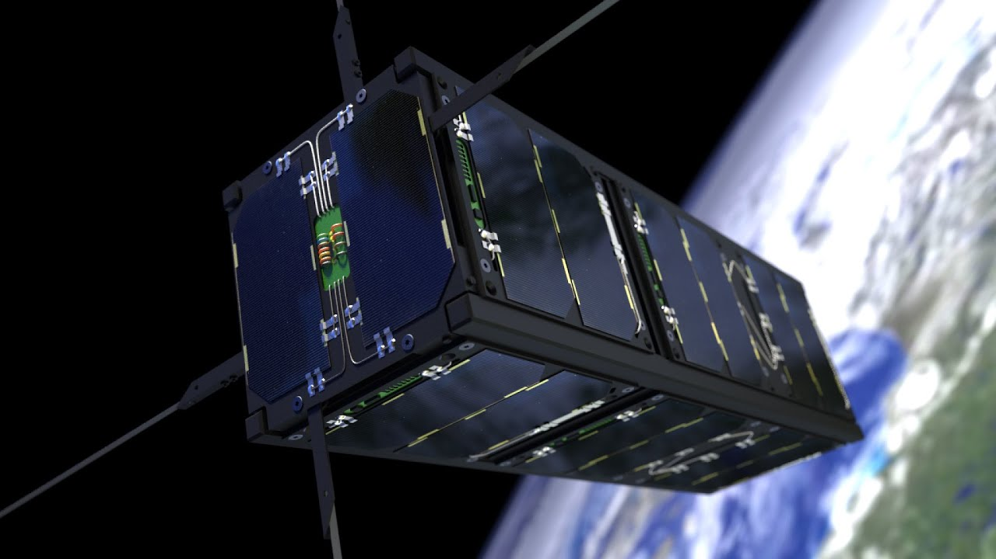
CubeSat Electrical Power System (EPS)

Slide 2
Introduction
CubeSat Electrical Power System (EPS) manages the power collection and distribution in the satellite with an integrated Battery Management System (BMS). The EPS stores generated energy in onboard lithium-ion batteries. Some of the EPS features are:
Power generation. Solar cells, bypass diodes, and energy harvesting.
Power safety and fault protection. Polyfuses, resettable fuses, TVS diodes, Schottky diodes, isolation relays, and a watchdog timer IC.
Connectors and wiring. Board-to-board connectors, PCB terminals, a power distribution board, harnessing, connectors, screw terminals

Slide 3
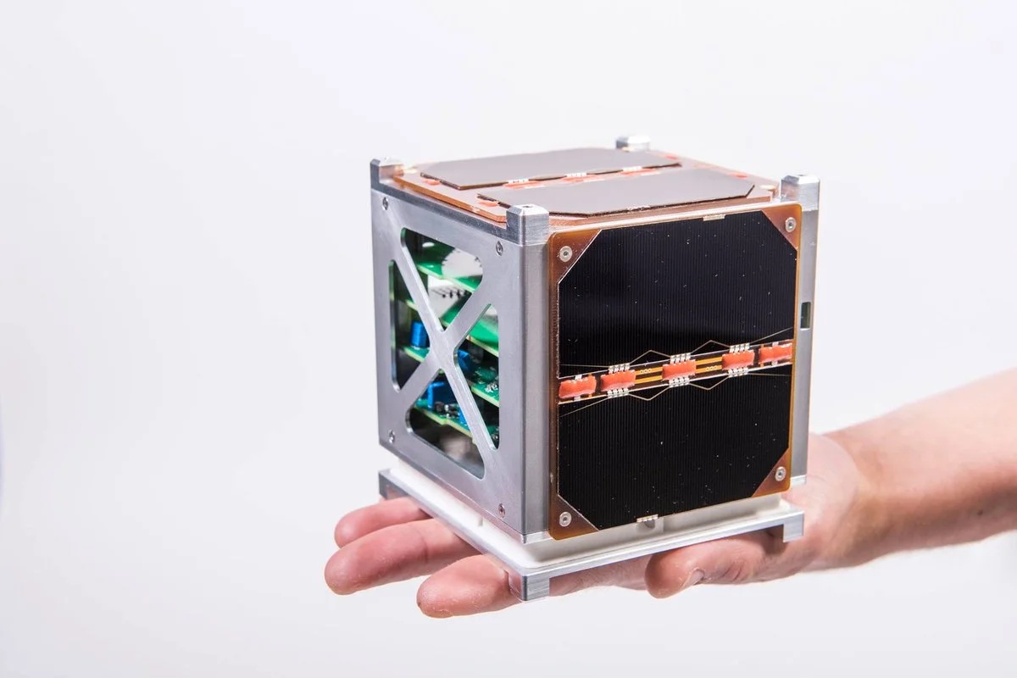
Project objective:
To create a demonstration model of a CubeSat EPS to study the principles of operation of small satellite power supply systems.

Slide 4
Relevance

